Slide 1


Web Scraping in Python (BeautifulSoup)

Slide 2
Outline
Quick Introduction: Web Scraping
Group Discussion. How do you plan to use Web Scraping in your research
Comparing Web Scraping vs APIs
Python Web Scraping Demo & Exercise

Slide 3
What brought you here today? (Breakout rooms)
Who you are?
What you hope to learn from today’s series?
How do you plan to use web scraping in your research?
Notes:
Who You Are
What You Do (methods, research areas)
What you hope to learn today/in this series?

Slide 4
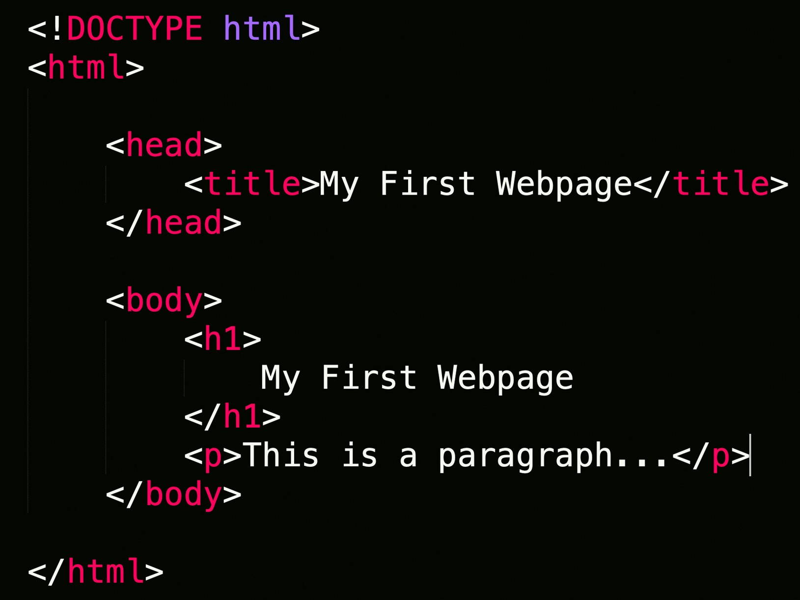
Web Scraping
Extraction of data from a website.
Loads HTML code from URL. User selects which content to keep

Slide 5


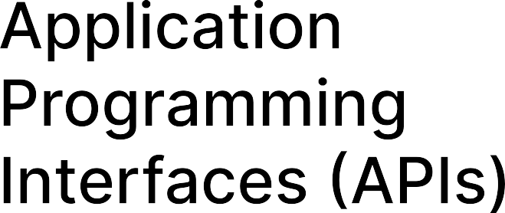
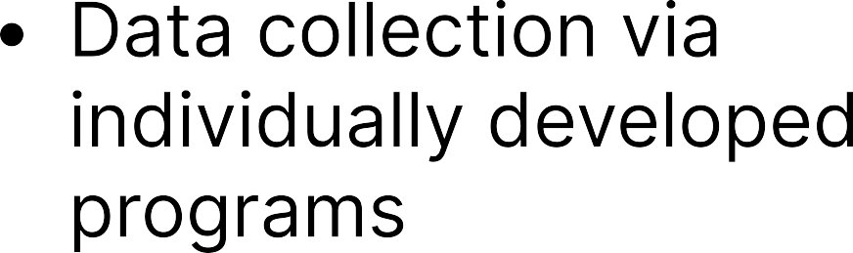
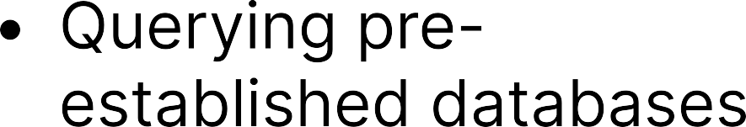
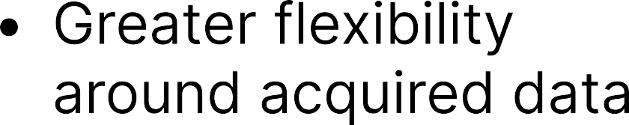
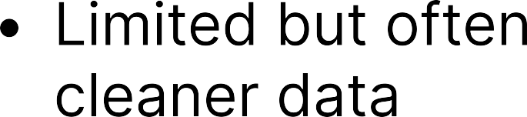
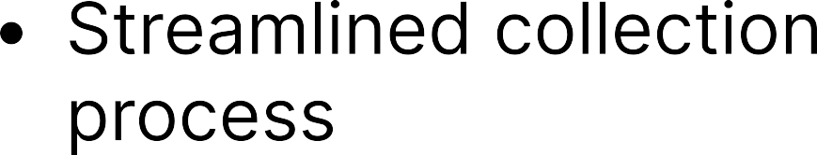
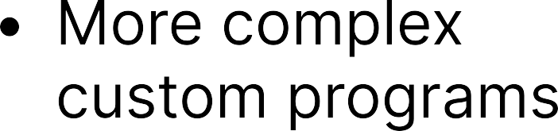

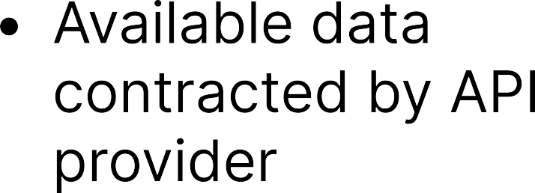
Web Scraping VS APIS

Slide 6







Slide 7
BeautifulSoup Coding Demo
Link Below to sample code
https://colab.research.google.com/drive/1FM2lQlVqkq8t1gu9paKacfcnLIfAHZKV?usp=sharing
Goal: Extract ‘Top items being scraped right now’ section. Pull item name, price, description, number of reviews.

Slide 8
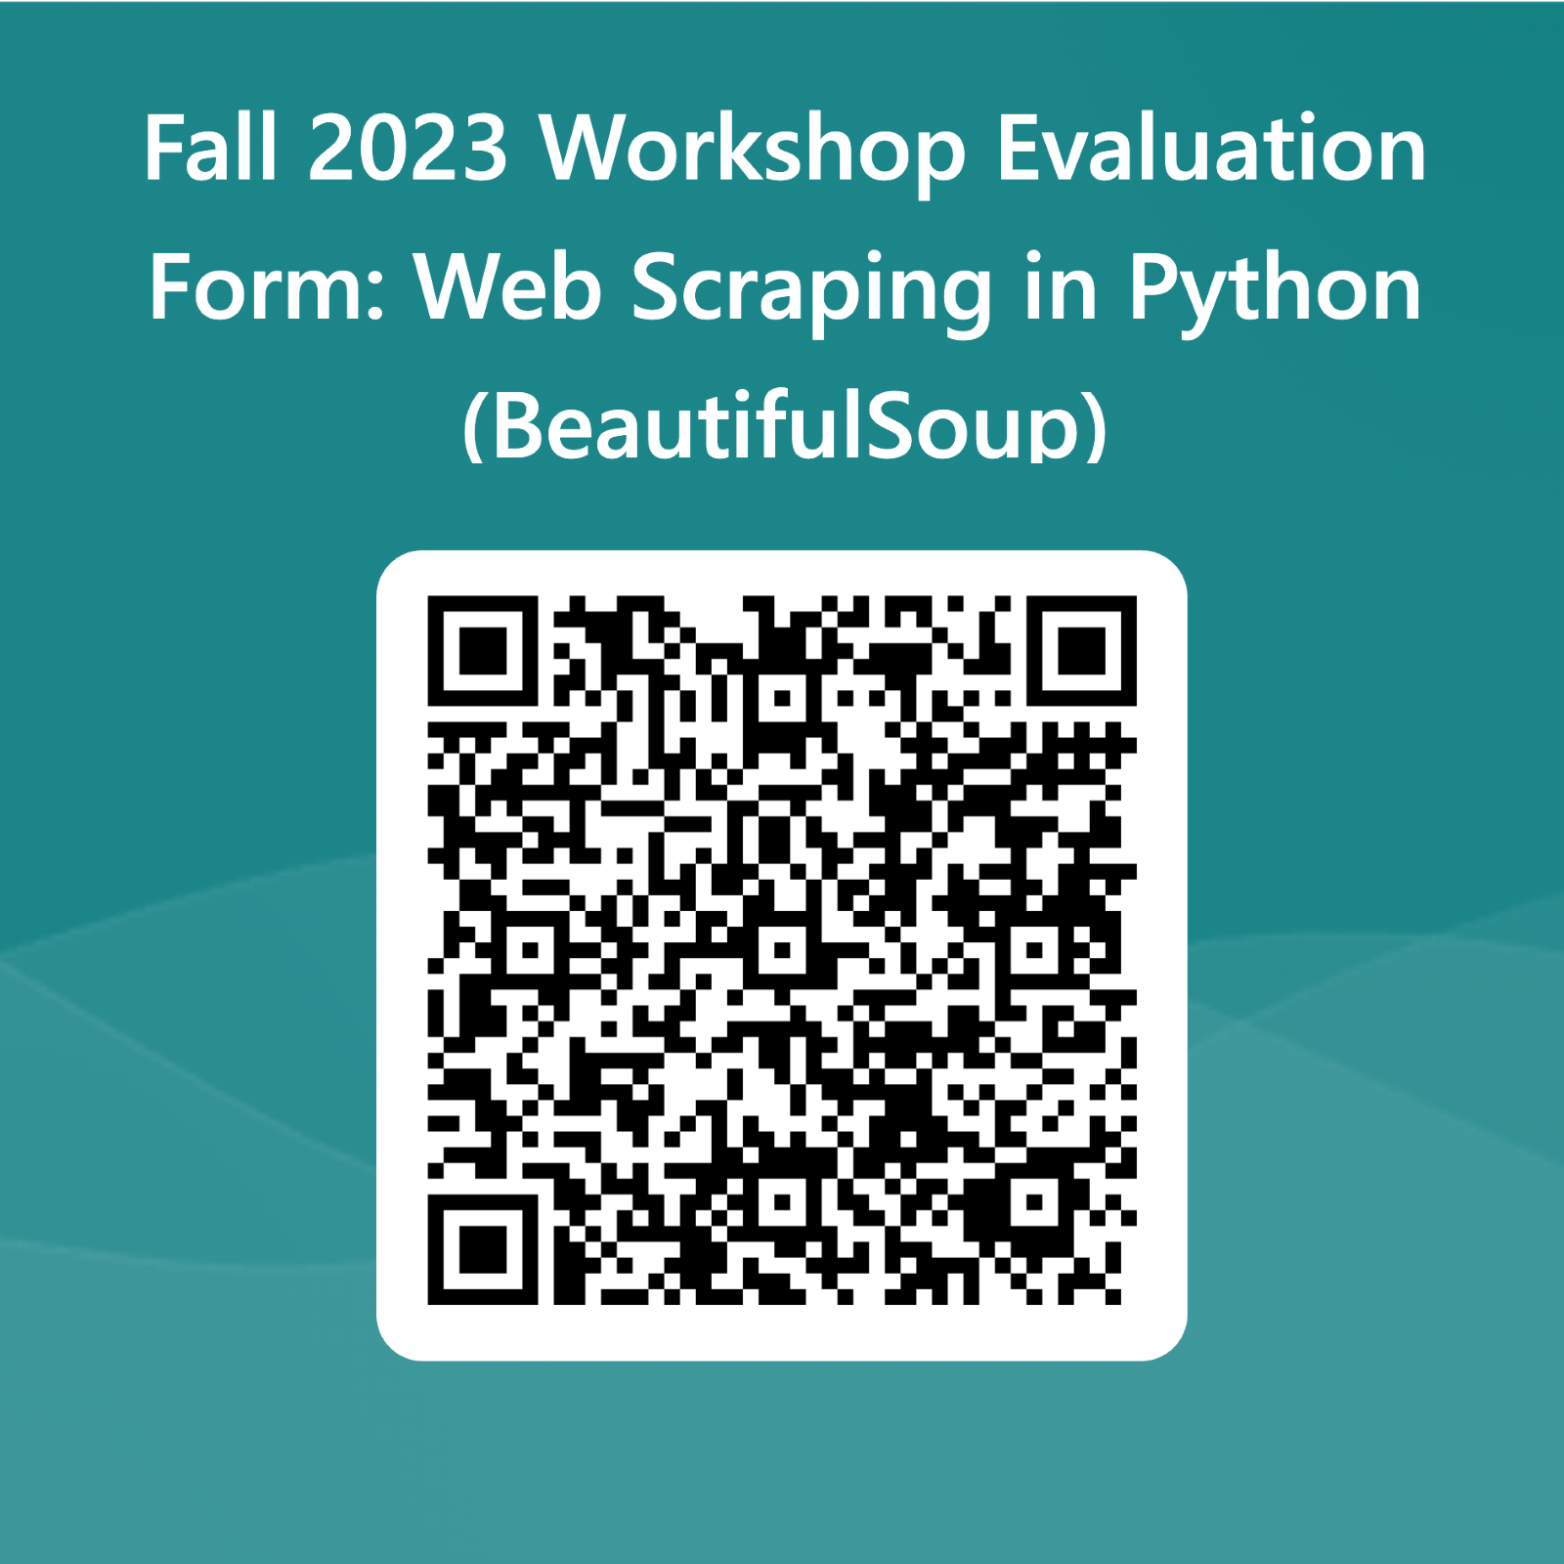
Evaluation

Slide 9
BeautifulSoup Coding Exercise
Link below to code. Fill in missing areas to complete scraping program
https://colab.research.google.com/drive/1Qv-qfO-ZWlI375GFRcOaNXVDq7a3WeTq?usp=sharing
Goal: Extract job title, job link, brief description provided.
Website URL : https://pythonjobs.github.io/
JRG363 Examples

Slide 10
Thank you!
Contact us at CCSS-ResearchSupport@cornell.edu

